Slide 1
Diversify with Plant Diversity
Farming in the 21st Century a practical approach to improve
Soil Health
Steve Woodruff
Agronomist
ENTSC
Notes:
Insert your name and title as appropriate

Slide 2
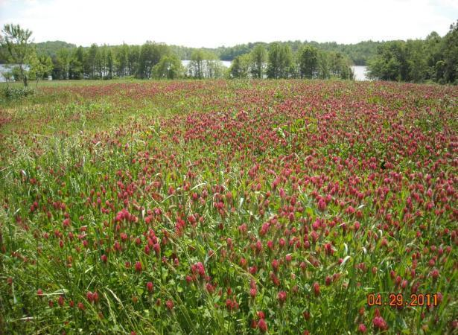
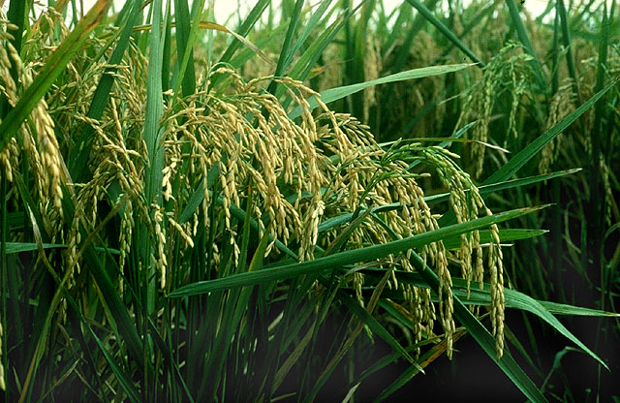
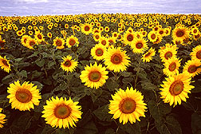
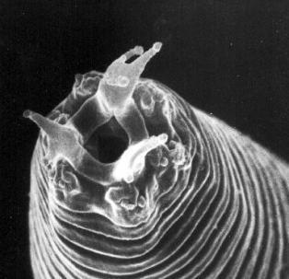
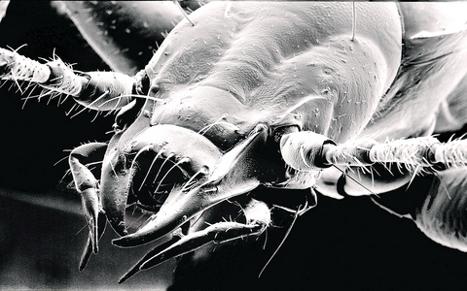
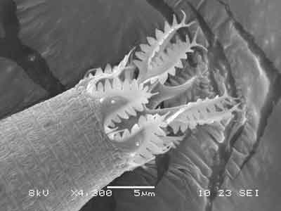
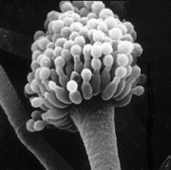
Diversity conduit for energy and nutrients.
Soil Surface
Notes:
Diversity conduit for energy and nutrients.
Ecological processes to optimize in agroecosystems:
• Strengthen the immune system (proper functioning of natural pest control)
• Decrease toxicity through elimination of agrochemicals
• Optimize metabolic function (organic matter decomposition and nutrient cycling)
• Balance regulatory systems (nutrient cycles, water balance, energy flow, population regulation, etc.)
• Enhance conservation and regeneration of soil-water resources and biodiversity
• Increase and sustain long-term productivity
Mechanisms to improve agroecosystem immunity:
• Increase of plant species and genetic diversity in time and space.
• Enhancement of functional biodiversity (natural enemies, antagonists etc.)
• Enhancement of soil organic matter and biological activity
• Increase of soil cover and crop competitive ability
• Elimination of toxic inputs and residues

Slide 3
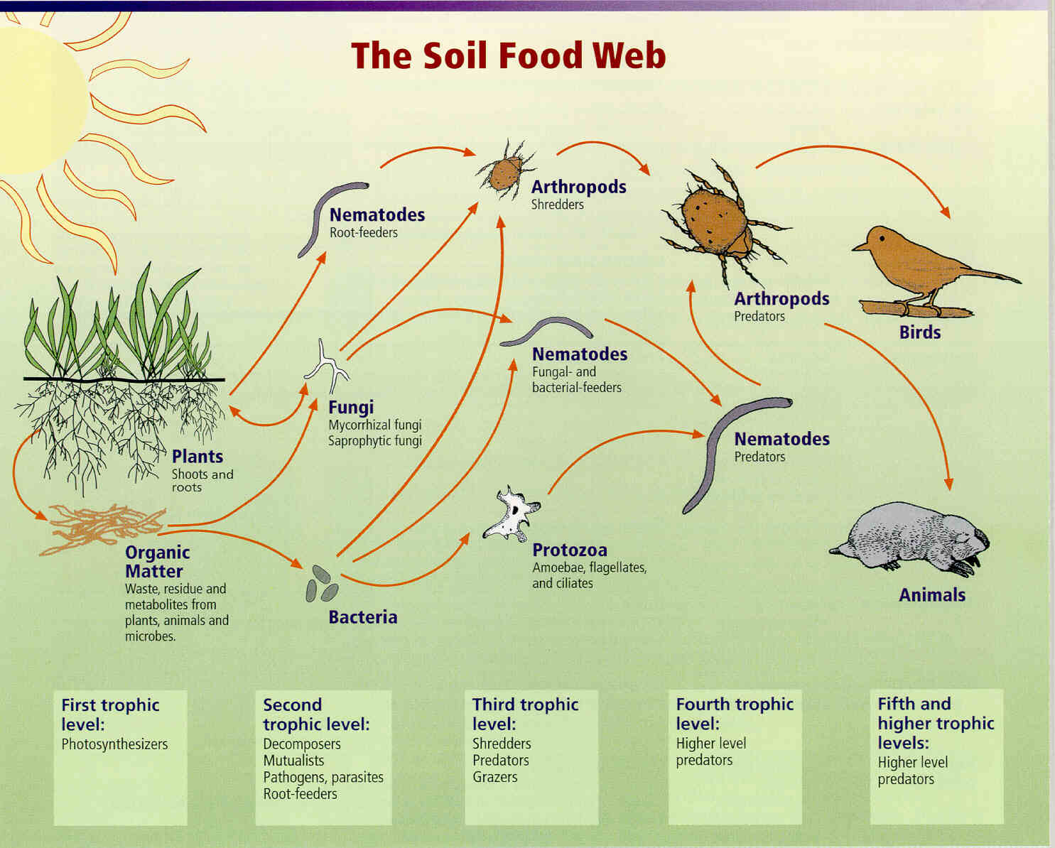
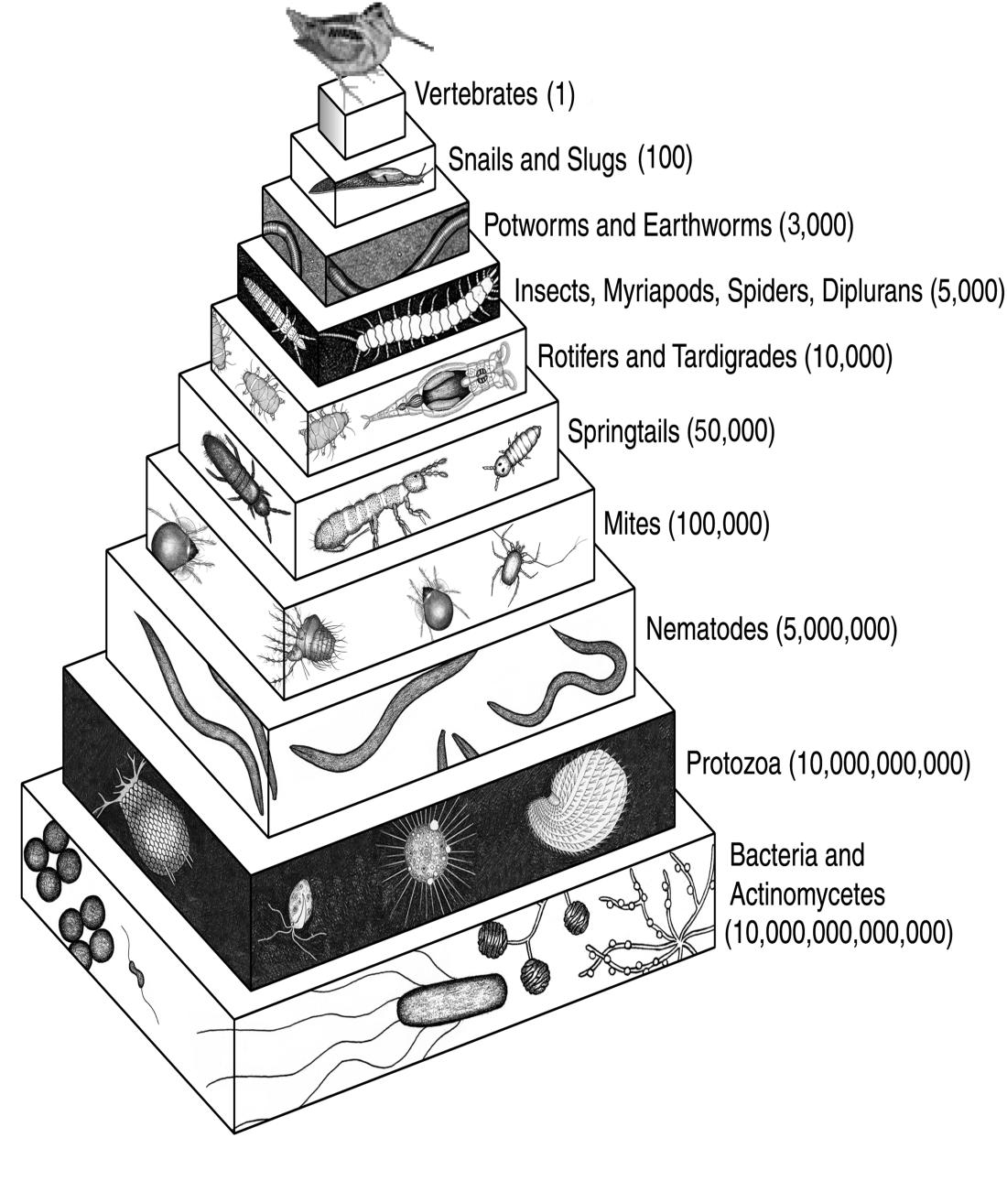
The Soil Food Web
Is complex
Every trophic level must function for the soil food web to function!
Dr. Nardi
Notes:
Most people are familiar with the above-ground food web: Plants are eaten by herbivores are eaten by carnivores, and so on. But most plant matter is not eaten by herbivores; it is decomposed by the underground food web.
Soil Foodweb is a community of organisms living all or part of their lives in the soil
Foodweb diagram shows a series of conversions of energy (arrows) and nutrients as one organism eats another
Foodweb fueled by primary producers (Photosynthesisers): plants, lichens, moss, bacteria, algae that use the sun’s energy to fix carbon dioxide
Most other soil organisms get their energy and carbon by consuming other organic compounds, organisms and waste by-products
All plants (grass, trees, shrubs, agricultural crops) depend on the soil food web for their nutrition.
File name: A-3 (145KB). (Also fw.jpg 574K, and fwb.jpg at 422K)
Image courtesy of the USDA-NRCS.

Slide 4
Diversify with Crop Diversity
Plants interact with particular microbes
  Trade sugar from roots for nutrients
Microbes convert plant material to OM
Requires a diversity of plant carbohydrates to support the variety of microbes
Lack of plant diversity will drive system to favor some microbes more than others

Slide 5
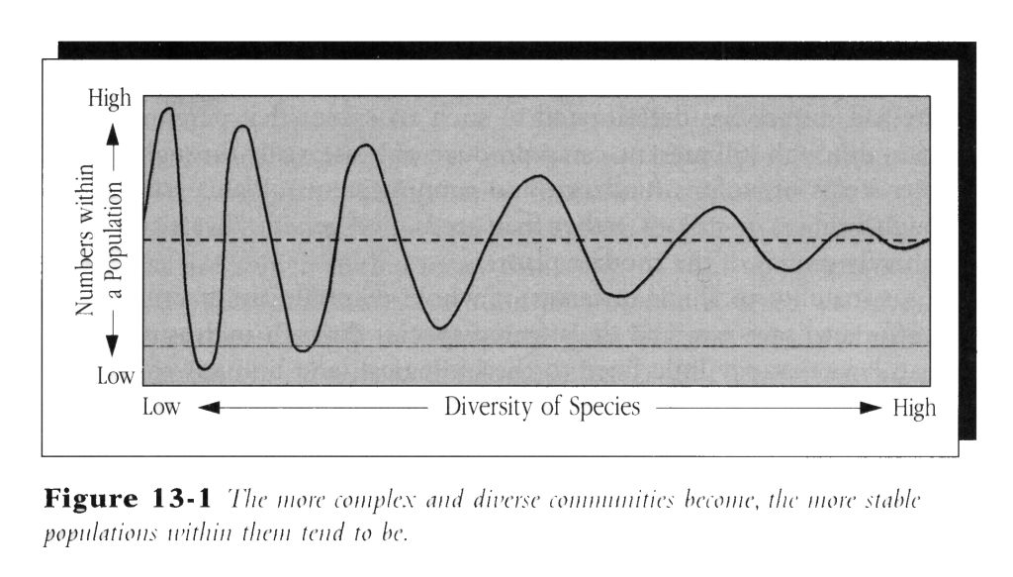
Stability tends to Increase with Increasing Complexity
Allen Savory: Holistic Mgmt
Notes:
This graph comes from the Allen Savory Holistic Management. The more diverse a population becomes the more stable it becomes. In the plant, animal and microbial population this hold true. More diversity the stable the population becomes.

Slide 6
How to Increasing Diversity in a Crop Rotation
Lengthen the rotation by adding more crops
  Increases soil organic matter
  Breaks pest cycles
  Improves nutrient utilization and availability
  Utilize available water deeper in the soil profile
  Provide windows for management
    spread manure
    Plant & harvest crops
Add more plants in the current crop rotation
  Utilize cover crops during non-cropping part of the year
Notes:
There are 2 basic ways to add plant diversity to a crop rotation
Lengthen the current rotation by adding more corps, e.g. corn-bean rotation goes to corn-beans-wheat
Benefits include:
Increase the amount of biomass produced can increase SOM
Planting difference crops breaks pest and weed cycles
Planting a variety of shallow and deep rooted crops utilizes soil moisture and nutrients
Provides windows of opportunity to spread manure in more suitable time of the year, plant and harvest crops with out conflict, etc.
Add more plants in the current rotation
Utilize the non-cropping portion of the year to grow cover crops
Be sure to use multi-species cover crops when possible

Slide 7
Diversity increases
Microbial community biomass
Microbial composition
Respiration
Fungal abundance
N mineralization rates

Slide 8
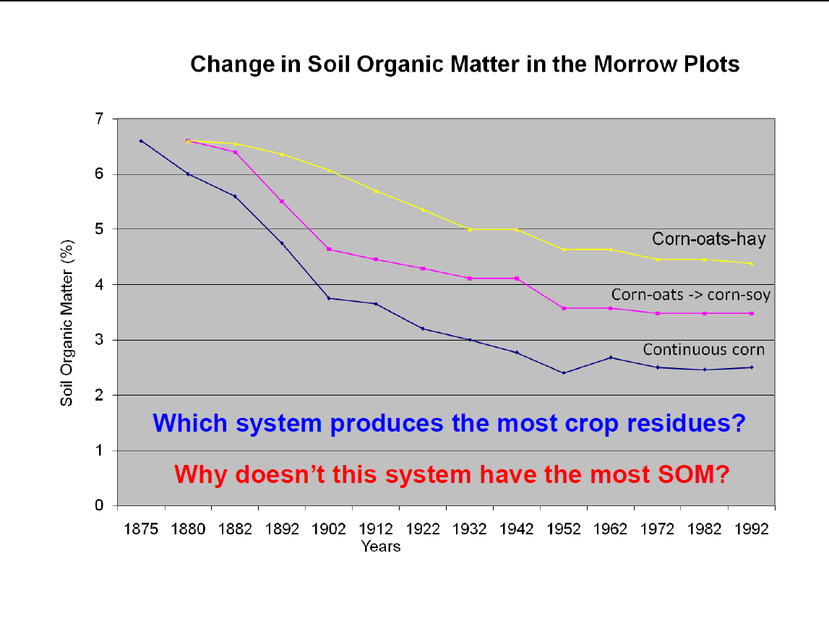
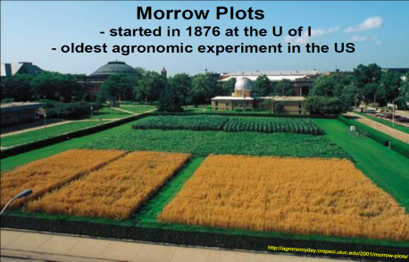
Notes:
Morrow Plots, University of Il. – 1876 – oldest agronomic experiment in the US

Slide 9
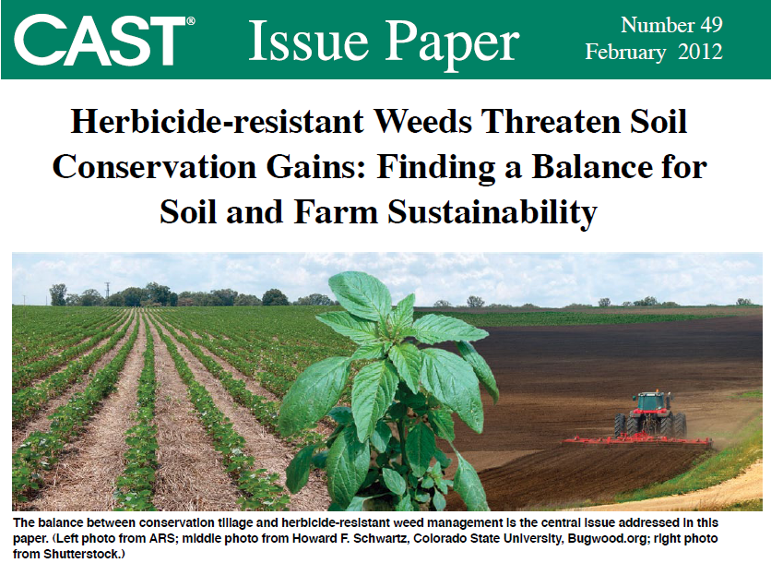
Notes:
NT cotton growers have gone back to tillage to control HR weeds! We have created this problem. Also, recent research- HR weeds are more resistant to disease: Glyphosate-resistant Weeds May Be Less Susceptible to Diseases
Link: http://www.purdue.edu/newsroom/research/2012/120717JohnsonSuper.html
Scientists searching for clues to understand how superweeds obtain resistance to the popular herbicide glyphosate may have been missing a critical piece of information, a Purdue University study shows. Purdue's findings, published online in the journal Weed Science, show that soil microbes may play a significant role in how glyphosate affects plants. The results also suggest that glyphosate-resistant weeds may be more resistant to disease pressure as well. "We may be selecting not only for glyphosate resistance, but inadvertently selecting for weeds that have disease resistance as well," explained one of the study's authors.

Slide 10
Some Plant Diseases Controlled Partially or Entirely by Rotation
Disease | Major Crops Attacked
Bacterial Blight | Wheat, Barley
Bacterial Wilt | Alfalfa
Black Dot | Potato
Black Shank | Tobacco
Granville (Bacterial) Wilt | Tobacco, Potato, eggplant
Northern Corn Leaf Blight | Corn
Smut (corn) | Corn
Stem Rot | Peanuts
Verticillium Wilt | Potato, Sunflower
White Mold | Potato, Soybean
Notes:
These are examples of crop diseases that may be partially or entirely controlled through crop rotations. Crop rotation may not provide complete control; however, with many diseases crop rotation can provide a significant contribution in a disease control program. For some diseases such as those that are spread by windblown spores, rotation may not contribute significantly to a reduction in the potential of occurrence of the disease.
Granville wilt is called brown rot in potatoes. Also, affects peanuts and tomatoes. Rotations with grass crops, particularly perennial are recommended to control bacterial wilt.
Improvements in reducing pest pressures because healthy fast growing plants are better able to compete with pests.

Slide 11
Cover Crop Role in Diversity
Allow you to look at cropping periods rather than years
Can be used to accelerate rejuvenating soil health
Getting 6 to 8 weeks of growth is adequate to get some of the “rotation” effect benefits!
Will increase soil biological diversity “Diversity above = diversity below”
Notes:
Cover crops and multi-specie cover crops play a big role in adding diversity into a cropping system
Farmers are hesitant to add more cash crops to a rotation, cover crops allow for diversity to be inserted into periods of the year that normally would not have a living root growing and no exudates being placed into the soil
Success of cover crops has always been judge by the amount of biomass produced above ground, we need to consider the amount of plant exudates that are feeding soil microbes for a period time that normally would not have gotten any food. Having roots grow for a short period of time accomplishes
Multi-species cover crops will added to the biological diversity within the soil

Slide 12
How to Incorporate?
Look for “Niche’s” in the rotation to add a growing crop
  Winter fallow six weeks before frost
  Summer fallow between crops
  Small Grain Frost seeding clover
  Full-year Cover crop mix
Determine what your objective is
  Scavenge nitrogen
  Reduce weed pressure
  Scavenge phosphorous
  Provide forage for grazing
Select appropriate crop
Make adjustment to accommodate

Slide 13
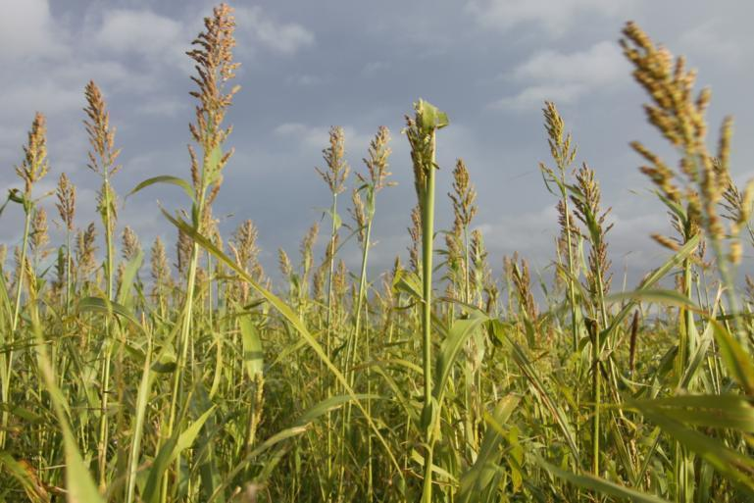
Crop Classification for Diversity
Plant morphology
  Broad leaf
  Grasses
Plant growth habits
  Cool season
  Warm season

Slide 14
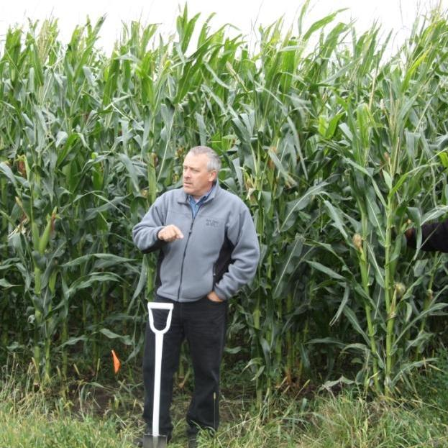
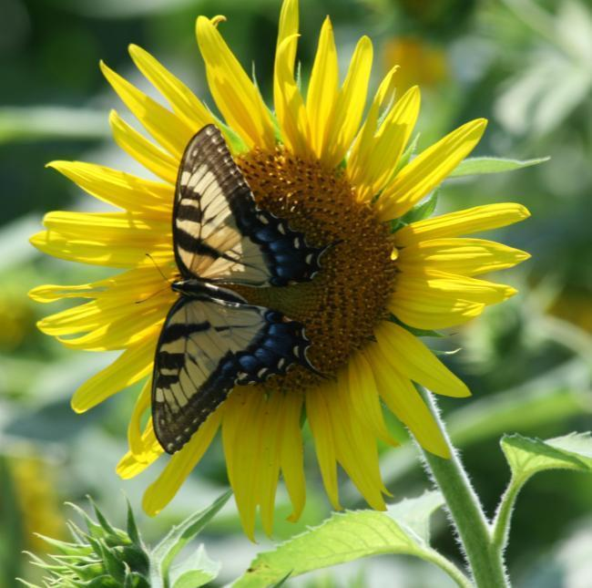
Crop Classification Warm Season
  Grasses
Corn
Millet
Sudan
Sudex
Sorghum
Broadleaf
Alfalfa
Soybean
Buckwheat
Chick pea
Cow pea
Sunflower

Slide 15
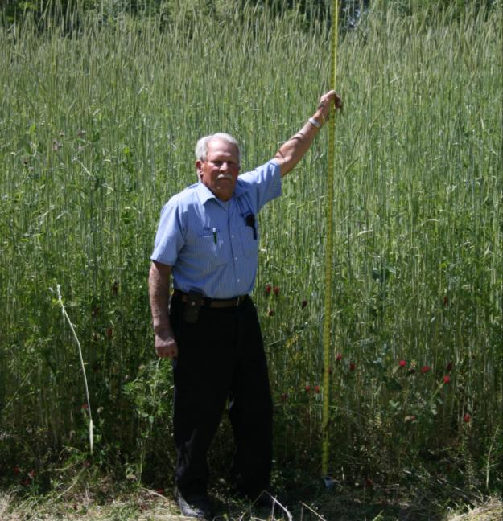
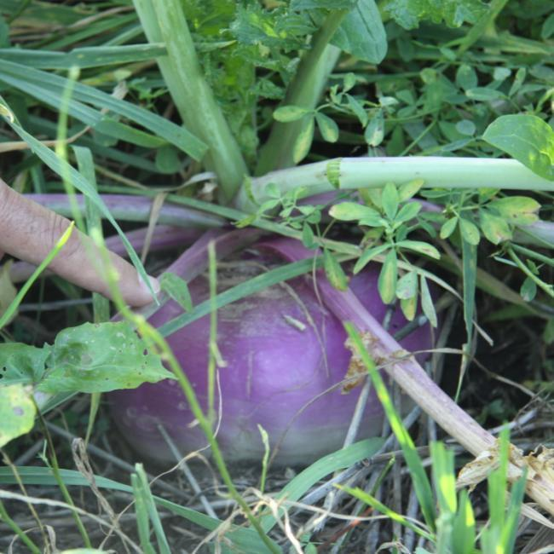
Crop Classification Cool Season
Grasses
Barley
Rye
Triticale
Wheat
Broadleaf
Canola
Clovers
Mustards
Pea
Radish
Turnips

Slide 16
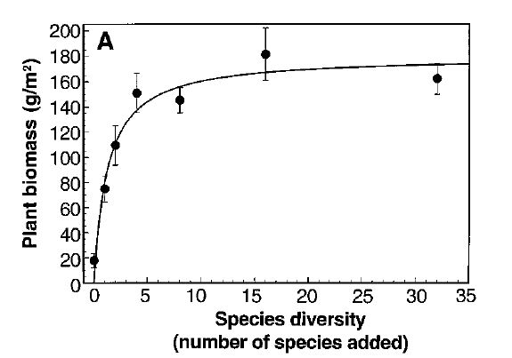
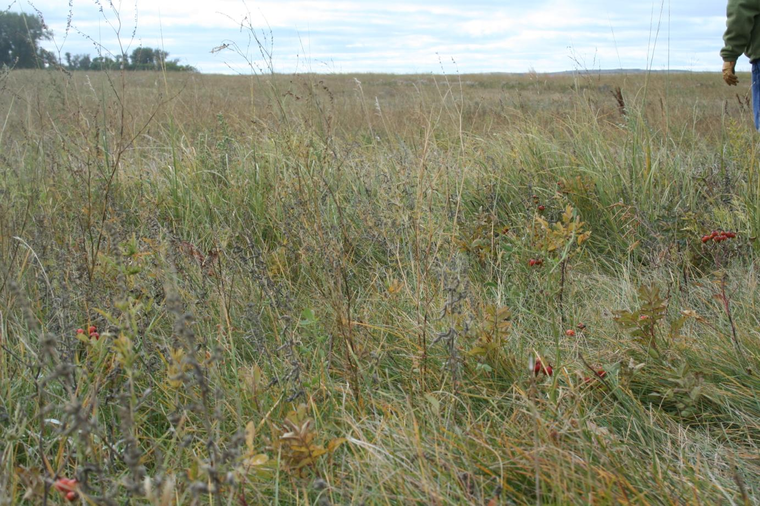
The Influence of Functional Diversity and
Composition on Ecosystem Processes

Slide 17
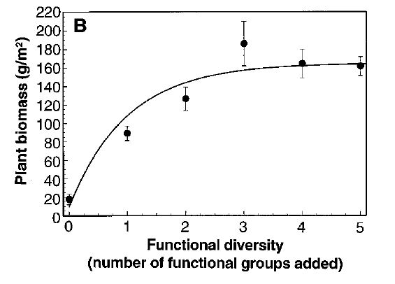
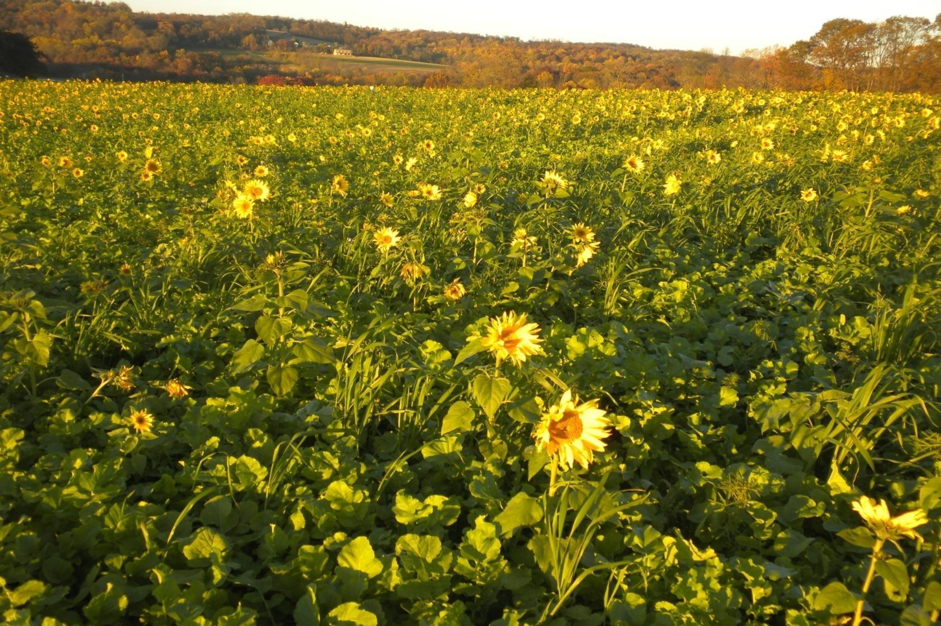
The Influence of Functional Diversity and
Composition on Ecosystem Processes

Slide 18

0 5 10 15 20
# of species

Slide 19
0 5 10 15 20
# of species
Diversity and Microbial Communities

Slide 20
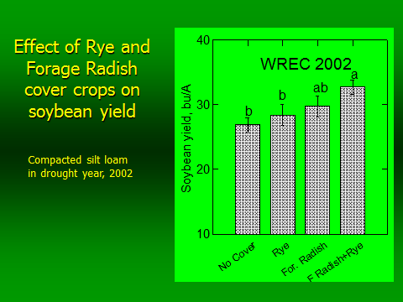

Slide 21
Notes:
2006 BCSCD data- at higher seed rate rate- diminishing returns

Slide 22

12 species
Notes:
Steve Groff Cover 12 species Crop Mix

Slide 23
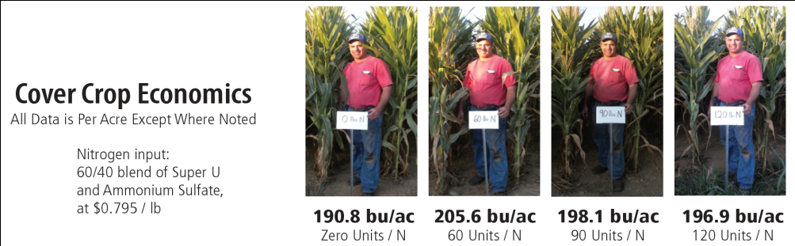
All Plots Harvested October 18, 2011
Study 3
190 bu/ac corn grown with zero N input at planting

Slide 24
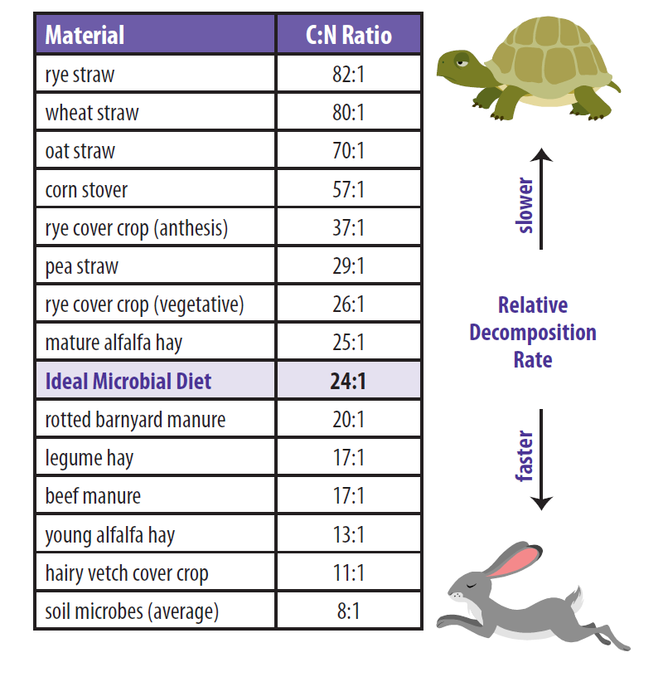
C:N Ratio for Various Crops
Rye
  High C:N
  Ties up N
  Compounds problem following another high C:N crop
Hairy Vetch
  Low C:N
  Release lots of N
  Decomposes Fast
Rye & Hairy Vetch Mix
  Balance C:N ratio
  Control decomposition
  Ideal cover crop mix

Slide 25
Nutrient Cycling
Carbon/Nitrogen Ratios
Soil Microorganisms, Bacteria * 5/1
SOM, Mollisol Ap horizon * 11/1
Rotted barnyard manure * 20/1
Mature Alfalfa Hay * 25/1
Protozoa ** 30/1
Corn Stover * 57/1
Wheat Straw * 80/1
Newspaper * 120/1
Deciduous Wood ** 300/1
Source:
*The Nature and Properties of Soils, fourteenth Edition.
DR. Nyle C. Brady and DR. Ray R. Weil
** DR. Elaine R. Ingham, Soil Food Web

Slide 26
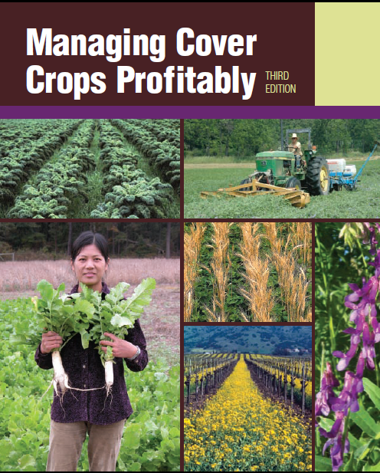
Cover Crop Characteristics

Slide 27
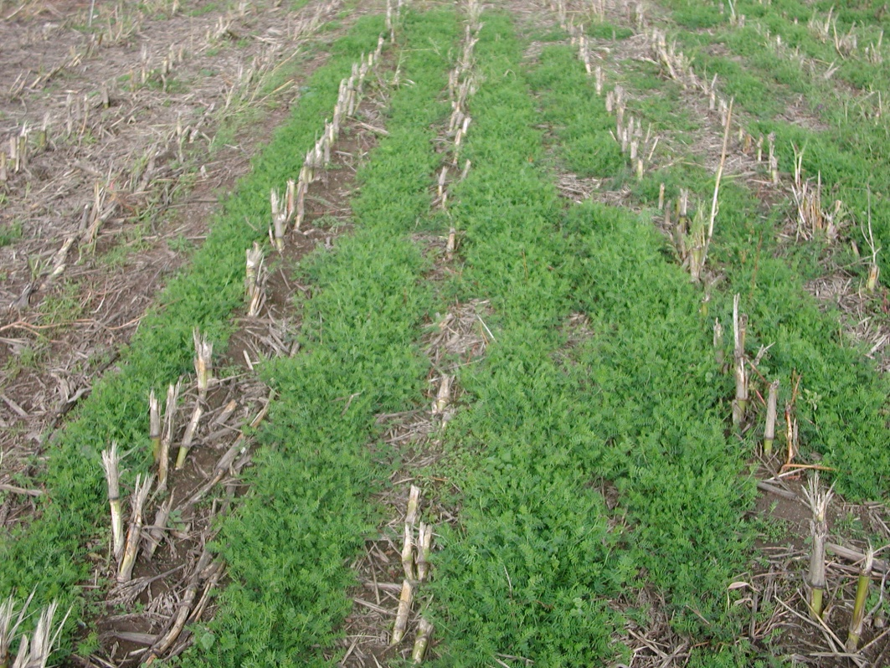
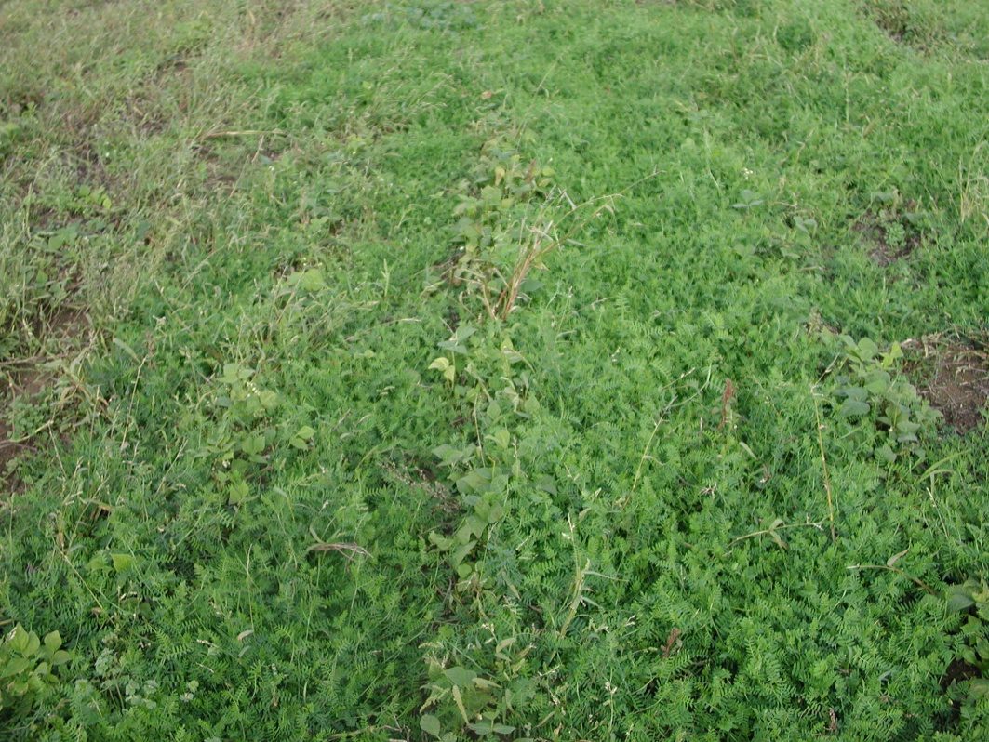
Hairy vetch good fall growth
Hairy vetch planted into
corn July 17
Photos 29 Oct 2003
Hairy vetch planted into
bean June 29

Slide 28

Fall Biomass Data
Dry Matter of Both Planting Dates Measured in November
Lose 50% to 80% of fall growth potential with a 1 month planting delay
Later planting defers growth potential to spring
Rye is the least impacted by a later planting date

Slide 29
Spring Biomass Data
Rye and triticale containing mixtures were least impacted by a later planting date
Ryegrass containing mixtures were moderately impacted by a later planting date
Legumes w/ no spring growing companions were heavily impacted by a later planting date

Slide 30
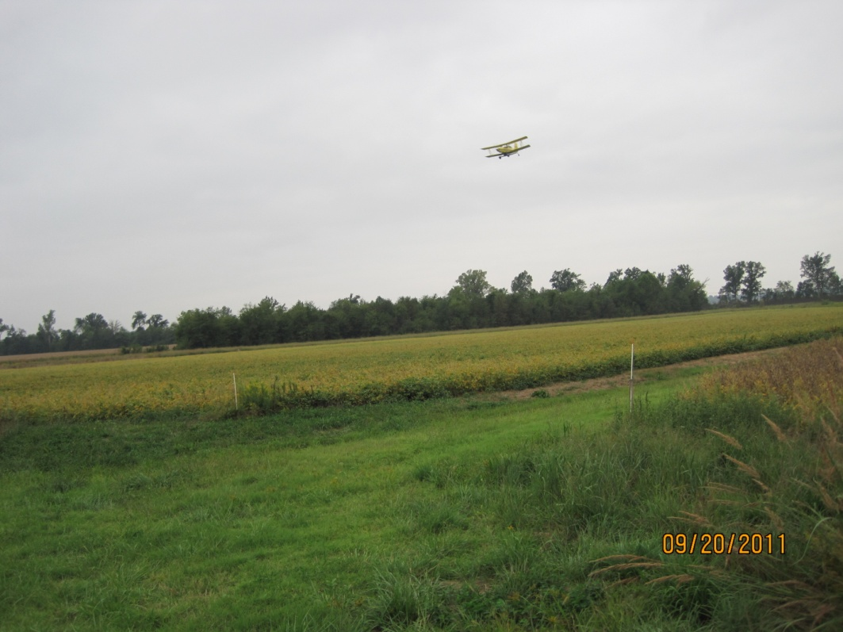
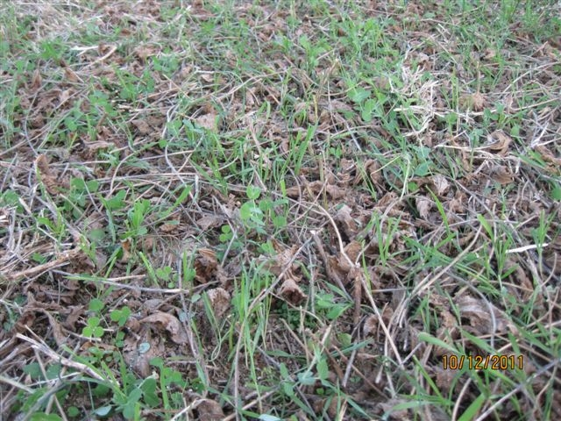
Aerial Seeding

Slide 31
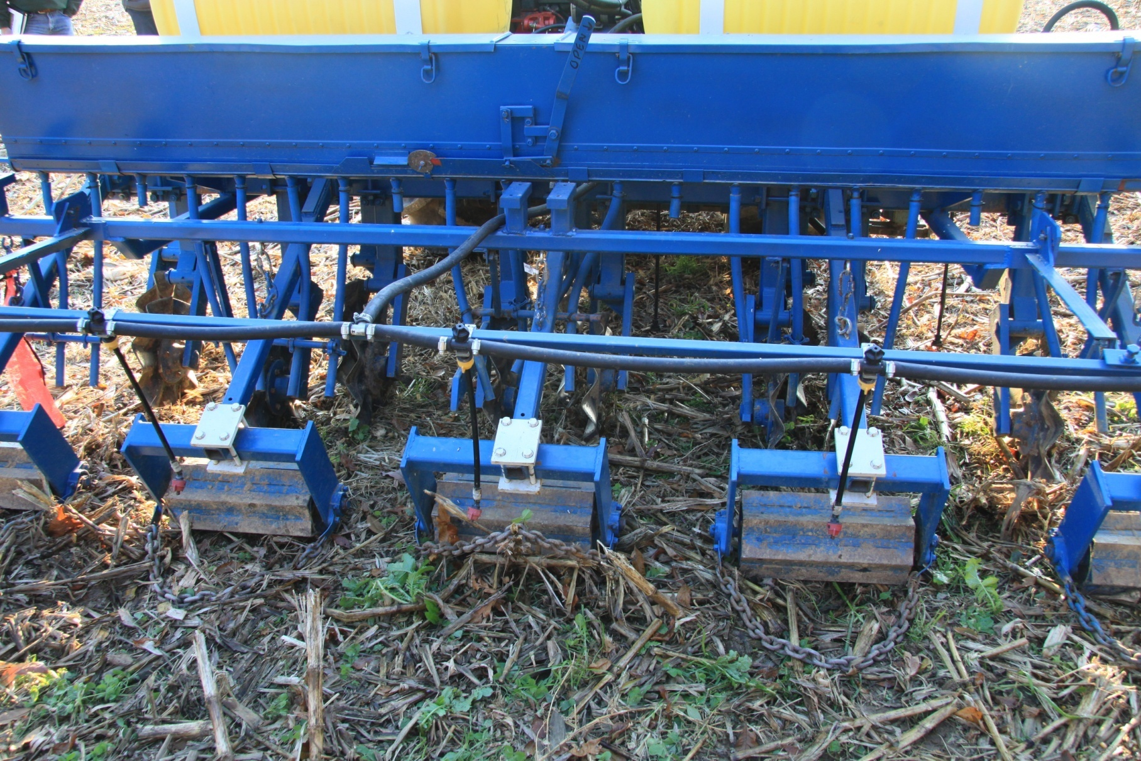
Penn State Cover Crop Seeder

Slide 32
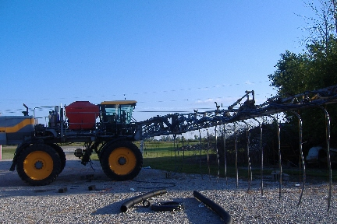
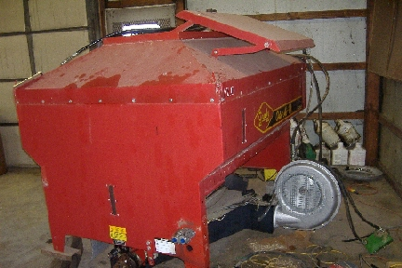
Seed cover crops into corn & beans
Uses a Hagie STS 12 with a Gandy Orbit Air seed box.
Covers 90 feet / 36 rows and the hopper holds 65 bu. “
Andy Ambriole’s Highboy air seeder

Slide 33
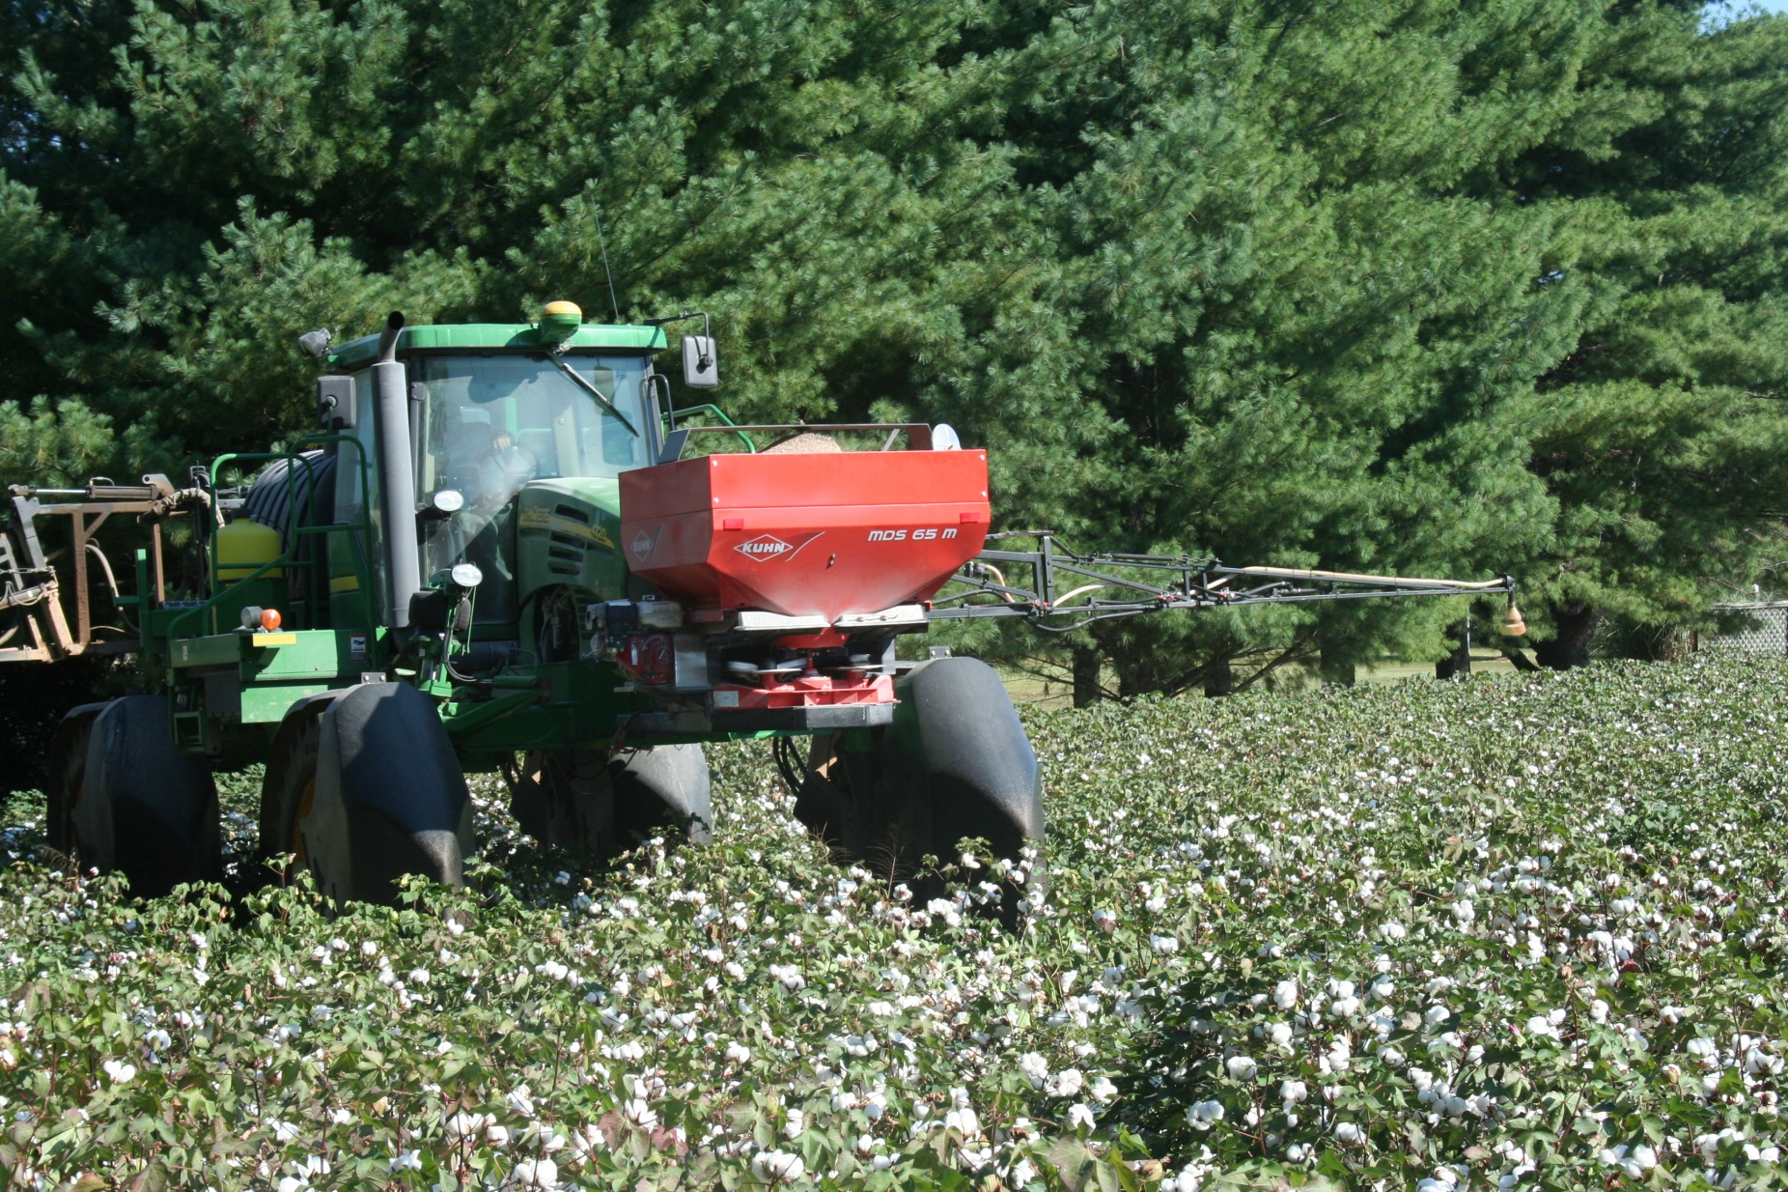
Broadcast while defoliating cotton

Slide 34
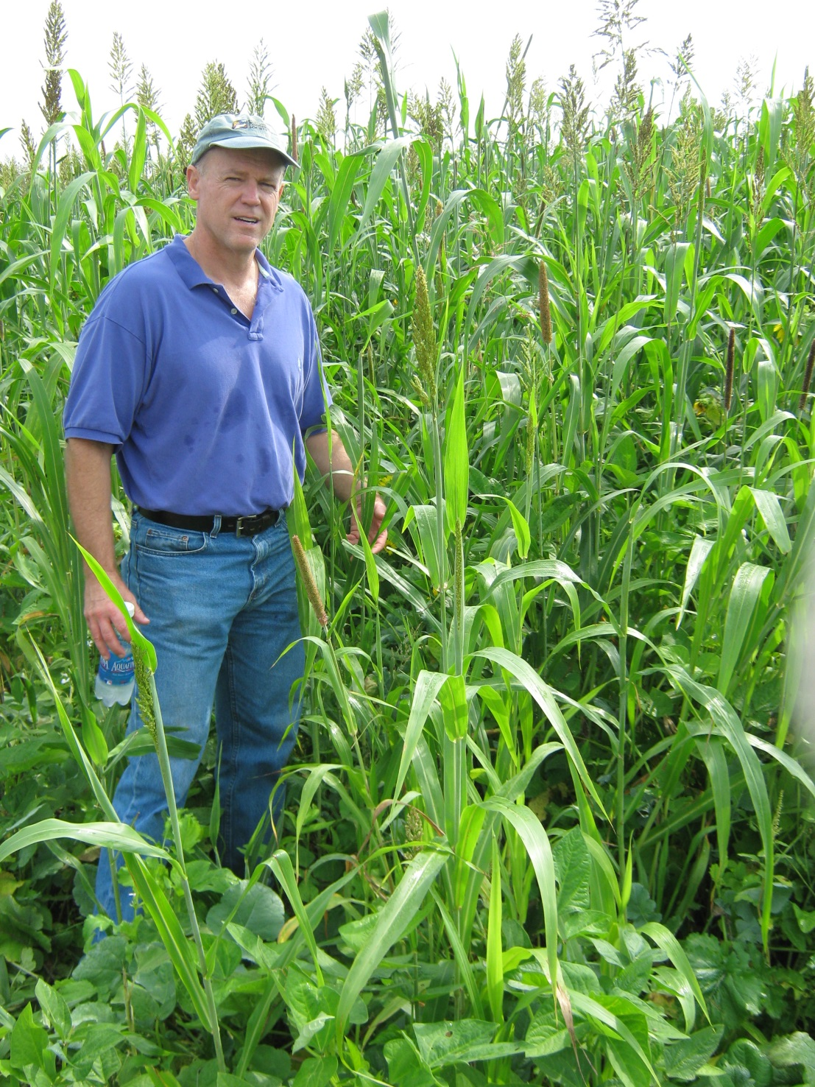
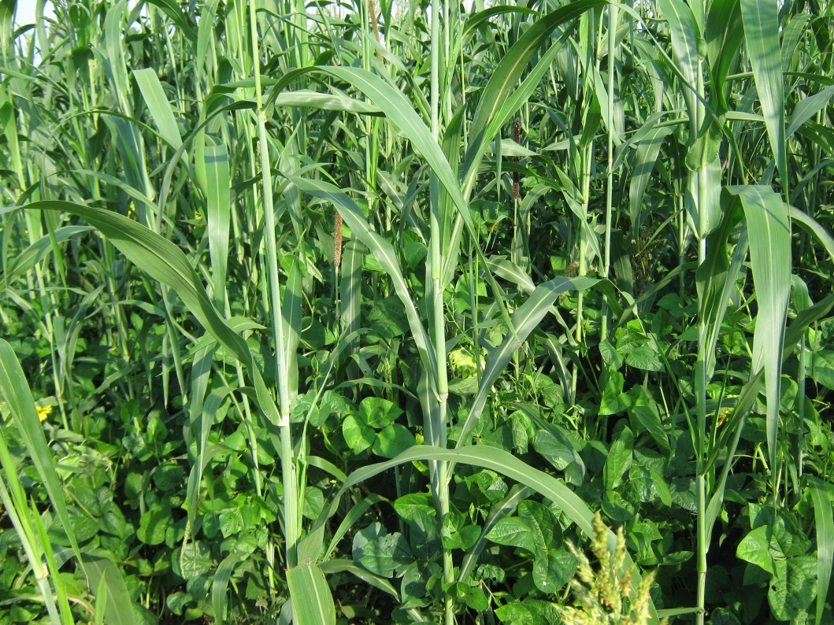
Soybeans 15 lb (Osage and Derry)
Cow pea, 12 lbs (Chinese)
Sorghum Sudan 8.5 lbs
Pearl Millet 5 lbs (NutriMil)
Sunflower 4 lbs (Peredovik type)
Graza Radish 2.5 lb
Burkank Turnip 1.5 lb
T-Raptor Hybrid Brassica 1.5 lb

Slide 35
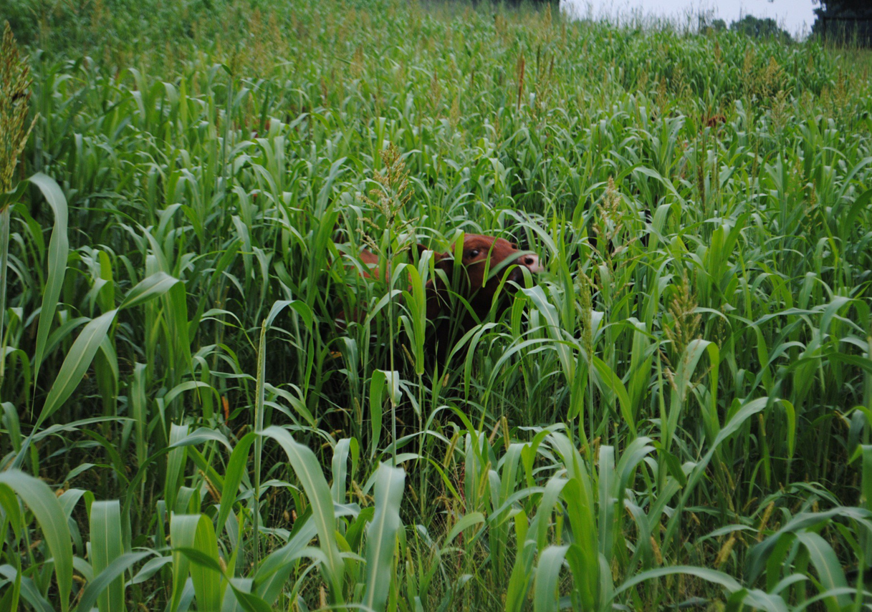

Slide 36
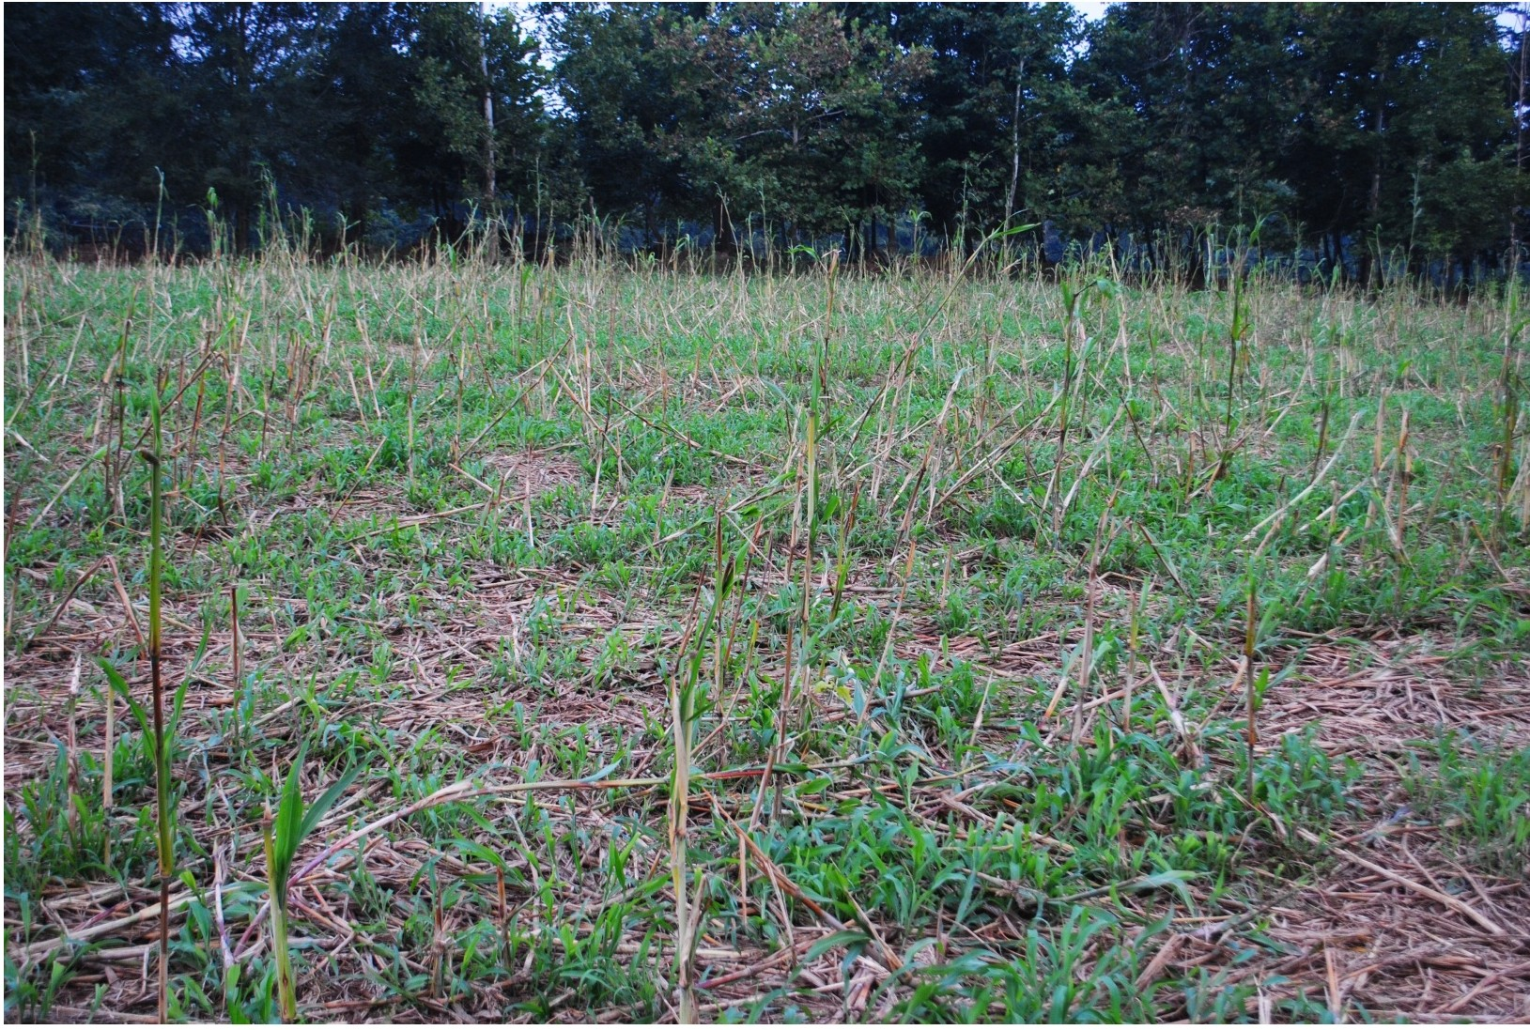

Slide 37
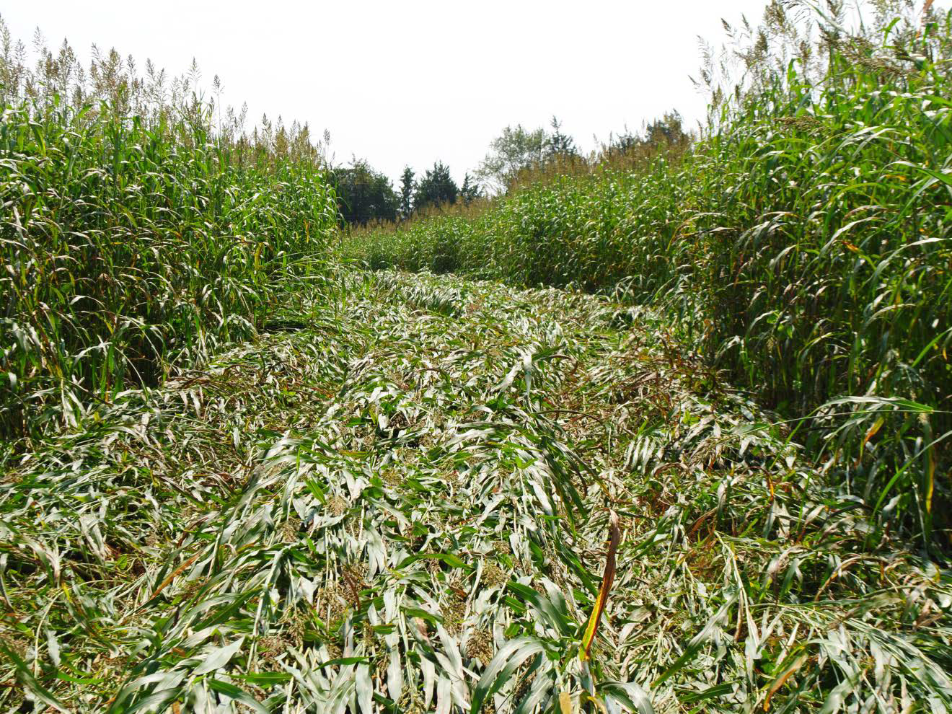

Slide 38
